Slide 1
Assignment TAbleau [MAJOR]-Shubham-bharti
File created on: 11/26/2022 5:09:28 AM

Slide 2
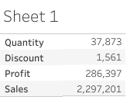

Slide 3
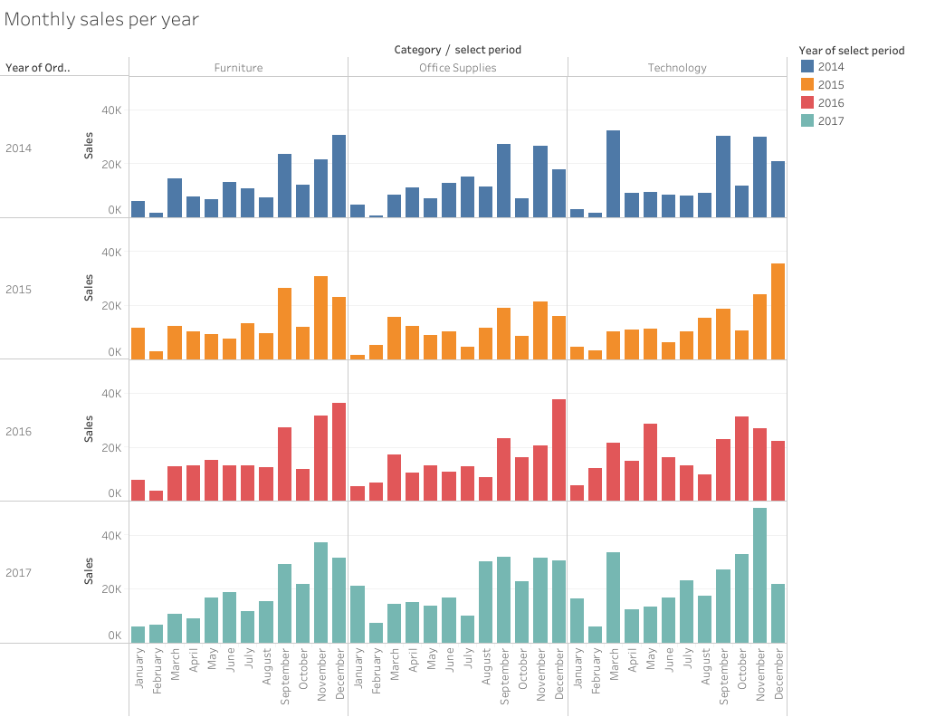

Slide 4
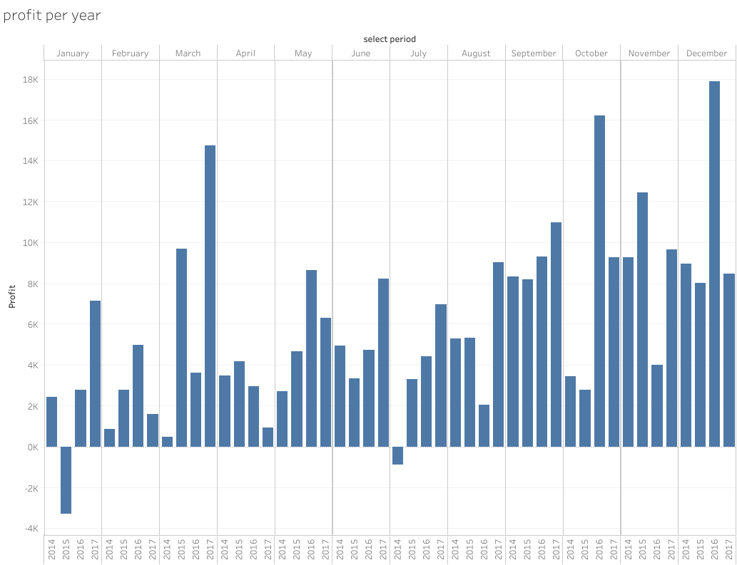

Slide 5
